Slide 1
NORTHWIND ANALYSIS

Slide 2
Analysis Objective
Product / Customer Analysis
Understanding
business nature of Northwind,
sales overtime (trend sales),
category and product performance
Customer behaviors
Shipper analysis
Employee analysis

Slide 3
Used Table
Order Details
Order
Customers
Products
Categories
Employees
Shippers

Slide 4
Product and Customer Analysis

Slide 5
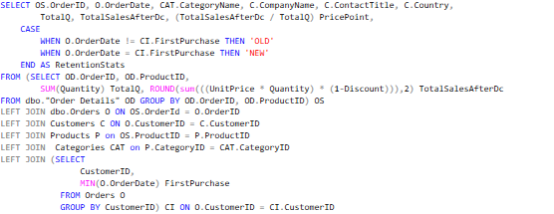
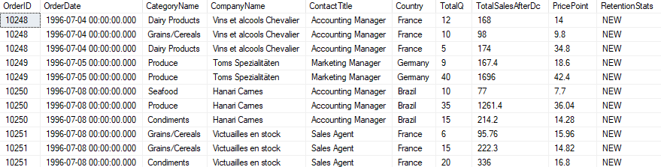
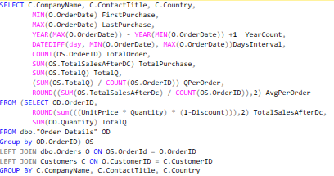
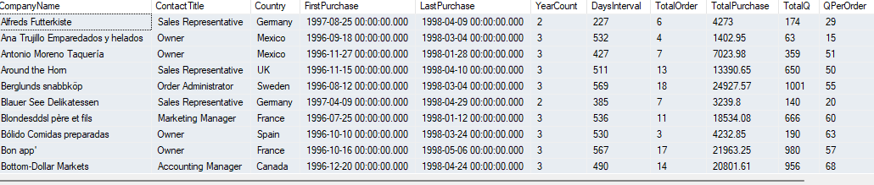
Used Code
Customer Transaction analysis
Customer analysis

Slide 6
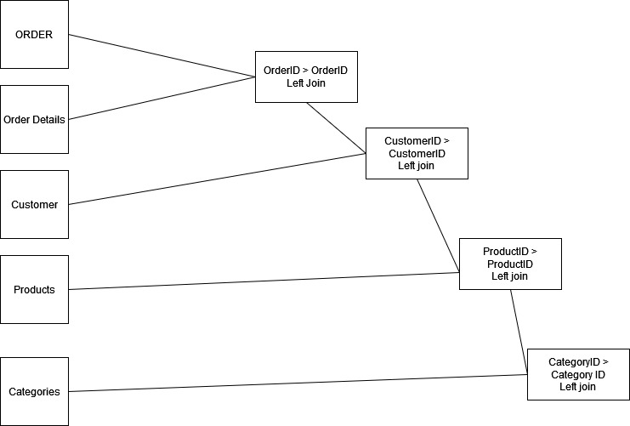
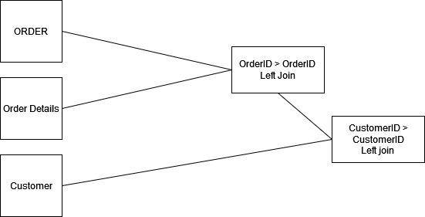
Customer Transaction analysis
Flow Chart
Customer analysis

Slide 7
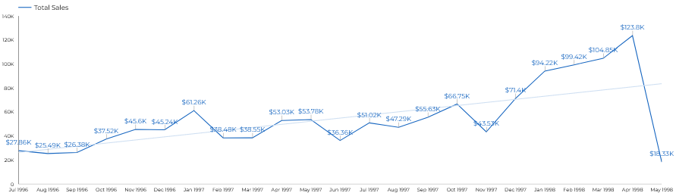
Sales Trend
Sales of Northwind grows overtime, the peak is on April 1998 but have been spiking from Dec 1977. Seeing from the trendline, the business is growing.

Slide 8
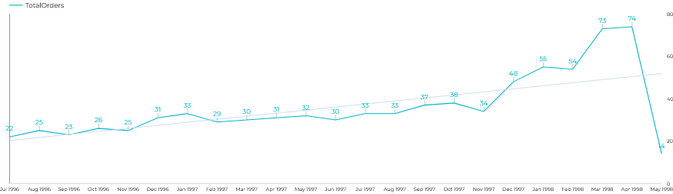
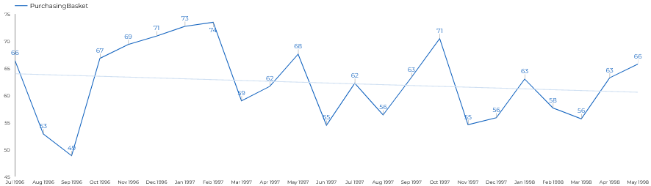
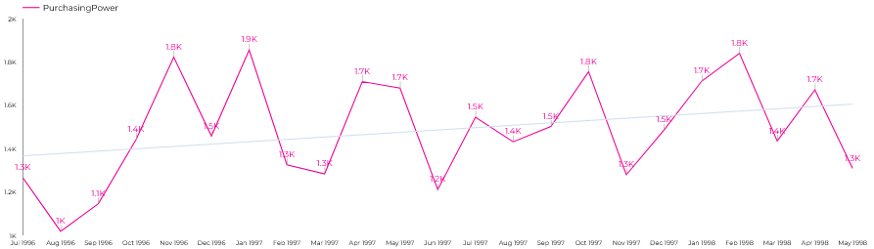
Multiple Trend Analysis
Compared to the trend of sales, trend of orders are relatively flat, except for between Dec 1997 to Apr 1998
Overall, the purchasing basket per month are averagely 62 items per transactions
Overall, the average total purchase per orders are 1500 Dollar.

Slide 9
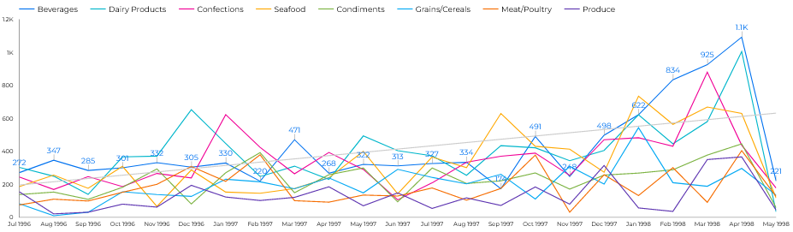
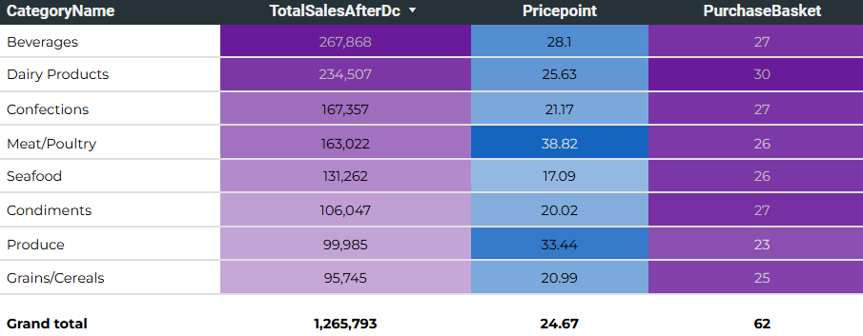
Category Analysis
The most sold category from July 1996 to May 1988 is Beverages, Follow by Dairy Products, Confections.
Meat/Poultry and Produce have more value in terms of pricing while Beverages and Diary Products pricing are near the averages

Slide 10
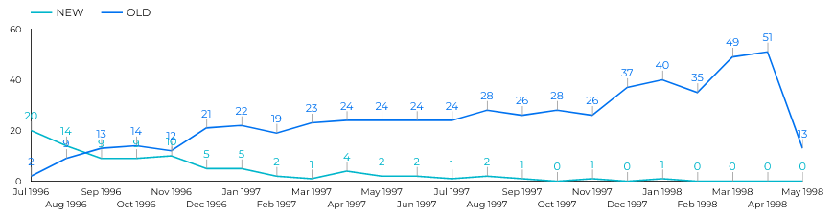
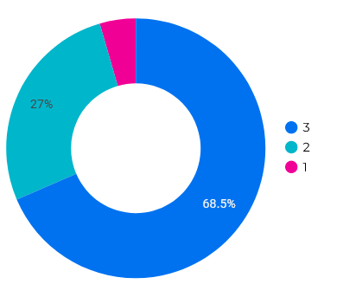
Retention Analysis
NEW vs OLD Order line graph
Customers age since first purchased
Recent Buyers are mostly from Old Customer (Customers who have purchased items before) which means there might be no more / little customer acquisition since September 1997. Moreover, majority of the customers have been purchasing from the store for 3 years. This may make the business seems working based on trust / loyal customers.

Slide 11
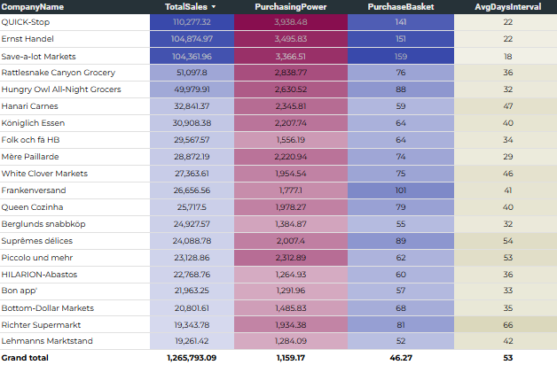
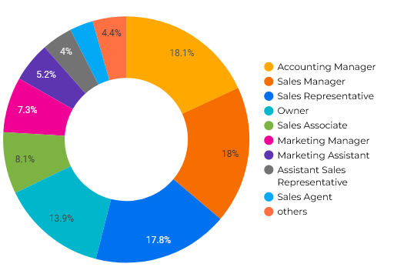
Customer Analysis
Contact Title
High in retention is making sense since the majority of companies of buyers are from supermarket.
The average days for one company to buy again from the store are 53 days. However, this information can help to retarget customers again if they have exceeded the usual days interval. (Asking why they don’t purchase again something like this)
The buyers are mostly from Marketing or sales division but, somehow as it can be seen that sometimes the buyer might be from accounting Manager and directly from the owner

Slide 12
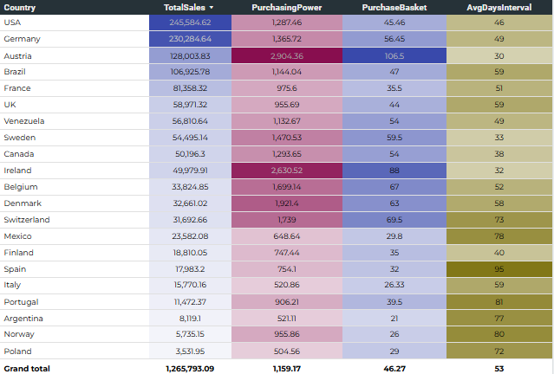
Customers’ Countries Analysis
USA and Germany are where the most sales coming from
Austria and Ireland have more value since the avg days interval are only 30ish days and they have higher purchasing power. This means, they are more frequent to restock their goods with big quantity
It is recommended to the sales division to create retention strategy for keeping Austria and Ireland in the loop.

Slide 13
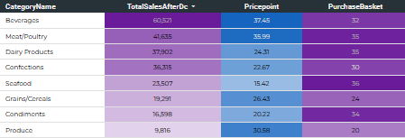
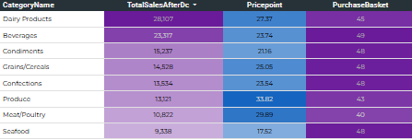
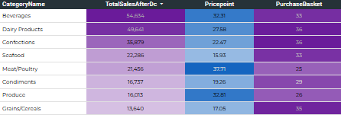
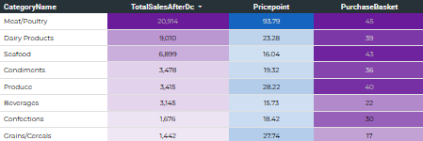
Countries’ Category Analysis
USA
AUSTRIA
Breaking down based on the country. Each country have specific preferred category and different price point
In Ireland, the most performing category sold are Meat/Poultry, the price point are much higher compare to the USA where the meat/poultry only cost for avg $35.39
Dairy Products are well performing in USA, AUSTRIA, GERMANY, IRELAND
Only IRELAND where beverages are not performing even though its price point are much lower than USA, AUSTRIA, GERMANY
GERMANY
IRELAND

Slide 14
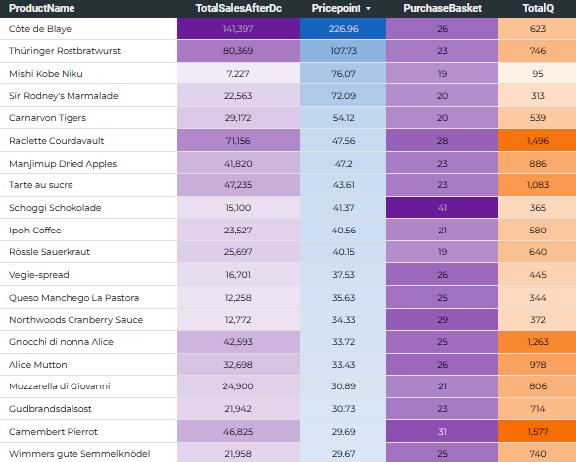
Product Analysis
Cate de Blaye is the most sold product in terms of value and has the highest price point compare to the other products
Meanwhile, Camembert Pierrot is the most sold product in terms of total quantity
Price point average is $24. The top sold 24 products are having much more than the average price point

Slide 15
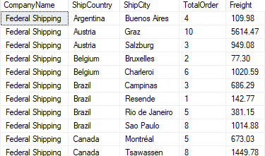
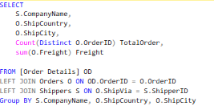
Used Code

Slide 16
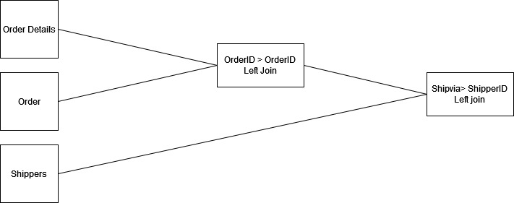
Flow Chart

Slide 17
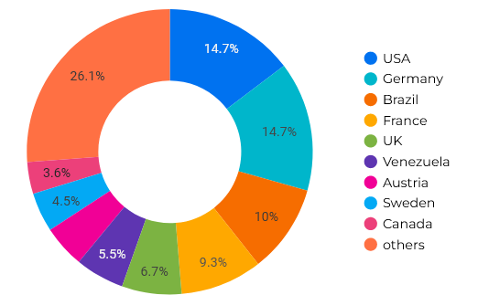
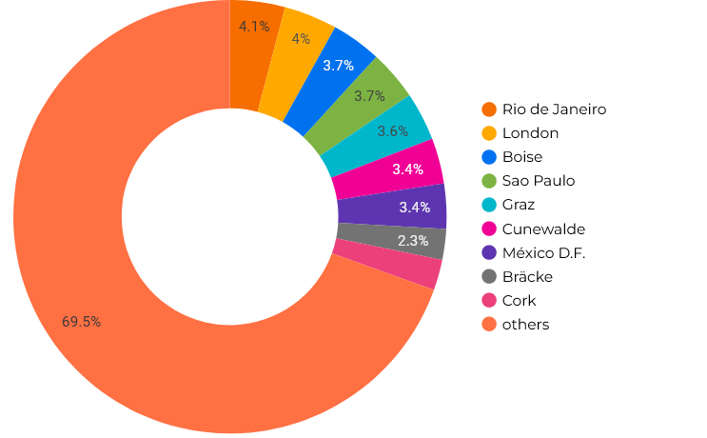
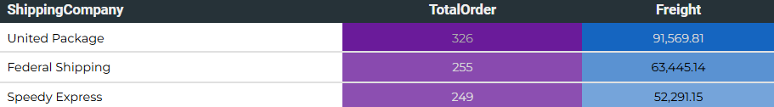
Shipper Analysis
Country ship to composition
City ship to composition
United Package are the most used shipper
Majority of the order are shipped to USA, Germany
Rio deJaneiro, London are frequently the city destination

Slide 18
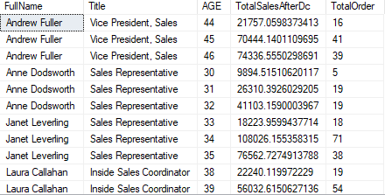
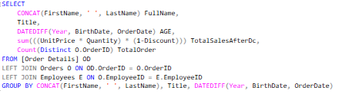
Used Code

Slide 19
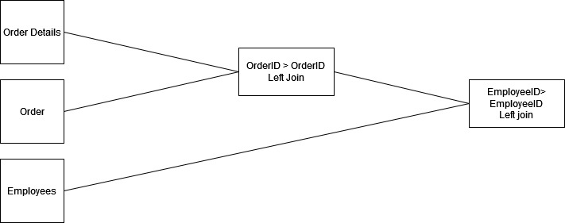
Flow Chart

Slide 20
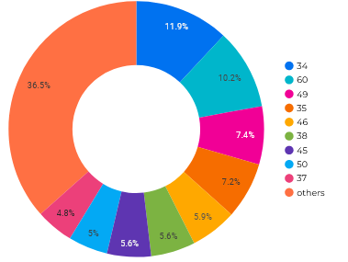
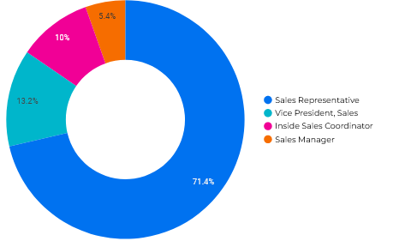
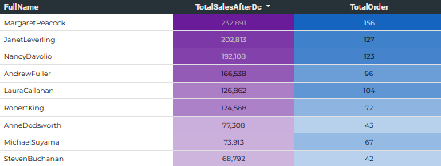
Employees Analysis
Employees age composition
Employees title composition
The most performing age that the sales representative made are 34, 60
Majority are sold by Sales Representative
Best sales is MargaratPeacock followed by JanetLeverling, and Nancy Davolio

Slide 21
Conclusion
Retention rate play major role in Northwind due to the business nature of supermarket that need to restock their products
After knowing countries’ preference, Northwind should be able to offer accurate products, stock more efficiently and acquire more customers in that specific country
Employees need to maintain the relation with customers since relationship are really important for this business

